Slide 1

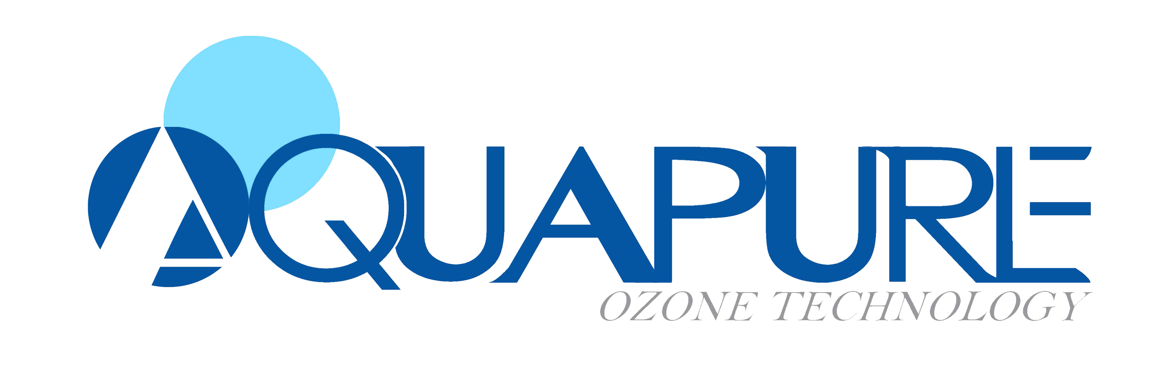
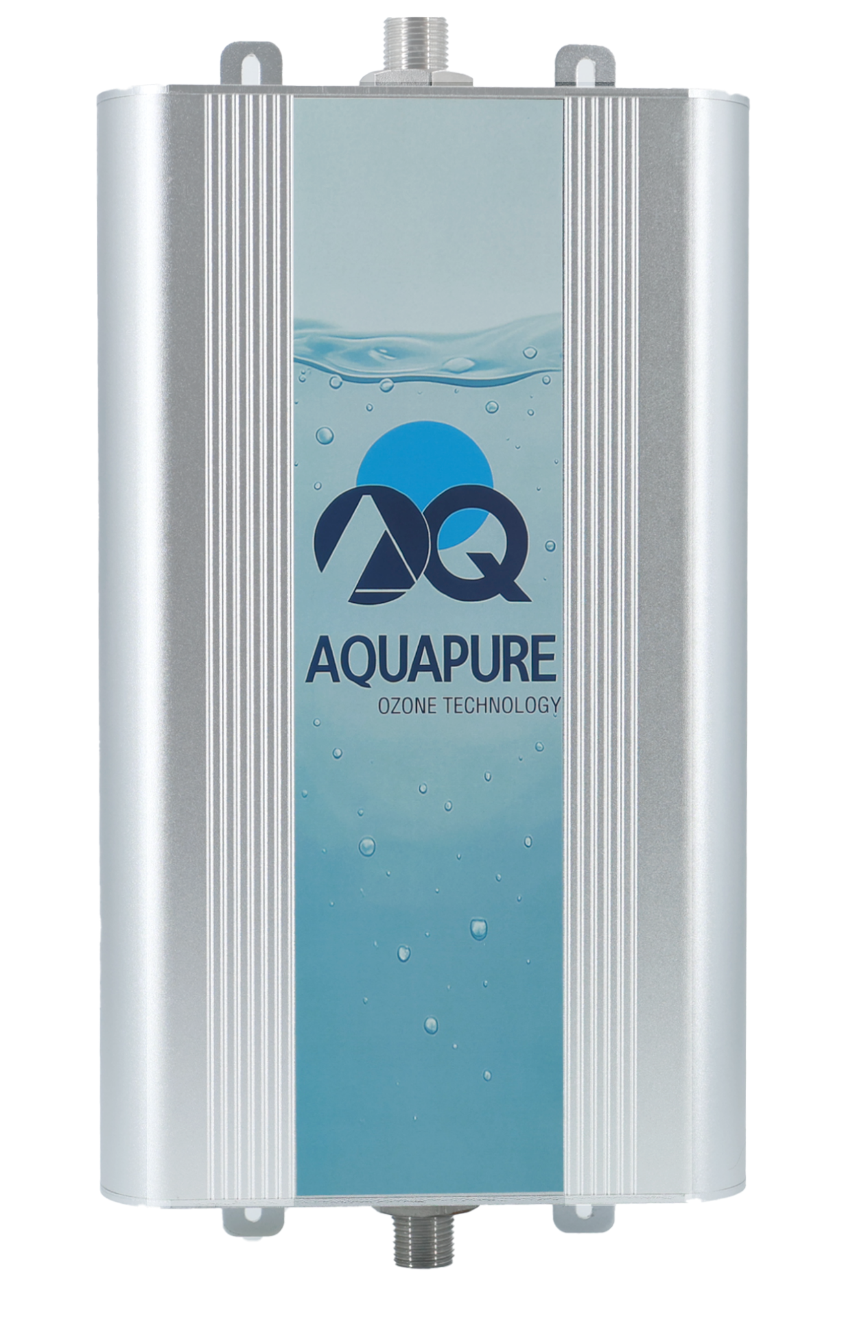
Diamond Powered Technology
Medical Grade Disinfection
Ozone Water Purifier AOT-DF-10

Slide 2
















Technical Specification
Product Name | Ozone Water Sterilizer
Mode No. | AOT-DF-10
Water Pressure | ≤ 1.5MPa (215PSI)
pH | 1-8
Working Temp. | 5 ～40 ℃
Rated Power | Max. 60 W
Voltage/Current | DC24V 6A
Weight | 4.0 Kg
Product Size | 330 × 198 ×69mm
Water Requirement | Pure Water or Tap Water
Application | Restaurant Hospital Kitchen Toilet , Veterinary hospital ,Grooming
Wide Range water flow
Deep Sterilization
Easy to Operate
Ozone Resistant
No Pollutation

Slide 3




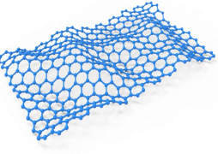









Technical Features
Strong Oxidizing Groups Sterilization Principle
FCD Diamond Electrode Technology
Strong oxidizing groups can oxidize the enzymes needed to break down glucose within bacteria, inactivating and killing them. They directly interact with bacteria and viruses, damaging their DNA and RNA.
Using FCD Diamond as a superelectrode, the electrolysis process breaks down tap water molecules and reconstructs disinfectant water containing strong oxidizing groups such as ozone (O3), oxygen atoms (O), and hydroxyl radicals (·OH).
H2O2 ·OH O3
H2O
H2O
Before Disinfection
H2
O2
After Disinfection
H2 O2
H2O
Diamond Electrode
Ecological Disinfectant

Slide 4














Ozone Disinfection VS Chlorine Disinfection
VS
Comparison Item
Ozone Disinfection
Chlorine Disinfection
Sterilization Efficiency
High efficiency, kills 99.9% of bacteria and viruses
Medium efficiency, limited effect on certain microorganisms
Disinfection Speed
Fast, typically only takes a few minutes
Slower, requires longer contact time
Environmental Friendliness
Decomposes into oxygen, no harmful residue
May produce harmful trihalomethanes and other byproducts
Residue
No long-term residue, environmentally safe
Long-term residue, may affect water quality and taste
Application Range
Wide range, can be used for water, air, surface disinfection
Mainly used for water treatment, limited in other applications
Odor Treatment
Effectively removes odors
May produce chlorine odor
Operational Safety
Generated on-site, no need to store hazardous chemicals
Requires storage and handling of toxic chemicals

Slide 5







Disinfection Range
AOT-DF-10 uses advanced FCD Diamond Electrode Technology to effectively eliminate various
bacteria, viruses, and molds
, remove
odors and harmful chemicals
, providing a
comprehensive disinfection solution.
Viruses
Bacteria
Molds
Effectively eliminates avian influenza virus (H5N1 and H9N2 subtypes), swine influenza virus, influenza virus (H1N1 subtype), and encephalomyocarditis virus.
Efficiently kills Escherichia coli, Staphylococcus aureus, Serratia marcescens, Listeria monocytogenes, and Micrococcus.
Effectively inhibits Trichophyton, Mucor, Aspergillus, and Cladosporium, preventing mold growth.
Odors
Harmful Chemicals
Allergens
Removes cigarette smoke (odor intensity decreased by 2.4 levels), barbecue smell, sweat (odor intensity decreased by 1.1 levels), durian smell, and methyl mercaptan.
Breaks down carcinogens like benzene[a]anthracene and pesticide residues including dichlorvos (77%), chlorpyrifos (98%), and methamidophos (92.3% reduction).
Effectively removes common allergens such as mites, Aspergillus, and pet dander, creating a healthier environment for allergy sufferers.

Slide 6


Disinfection Rate
Sterilization Efficiency Data
Bacterial viruses
Concentration （CFU/ml）
O3 level
（ppm）
Contact Time（S）
Death rate（%）
The killing rate of Escherichia coli, Staphylococcus aureus, etc.
99.9%
E. coli
Staphylococcus
Pseudomonas aeruginosa
influenza virus
Canine parvovirus
Pan-infectious hepatitis virus
105
105
105
1053ED50 1040ED50 1010ED50
0.96 1.08 1.01 0.96
0.96 1.2
5
5
5
15
10
20
99.9
99.9
99.9
99.9
99.9
99.9
Use O3 water to soak fruits and vegetables, and the degradation rate of pesticide residues is up to
85-99%

Slide 7




Disinfection Advantages
LOW COST
Advanced Tech
FAST
Zero Residue
5-10%
Calculations show that the cost per liter of water treated is only 5%-10%
of similar products, offering
significant economic advantages.
5x
Core FCD diamond electrode technology
5 times more durable than ordinary electrodes! 30% higher oxidation sterilization efficiency.
30s
Generate Ozone Instantly
Complete disinfection in 30 seconds.
Kitchen (fruits and vegetables, knives, countertops), medical (nursing tables, hand sanitizer), etc.
Kills 99.9% of bacteria in 30 seconds, instantly severing the contamination chain.
0%
After disinfection, it decomposes directly into water, oxygen, and carbon dioxide.

Slide 8
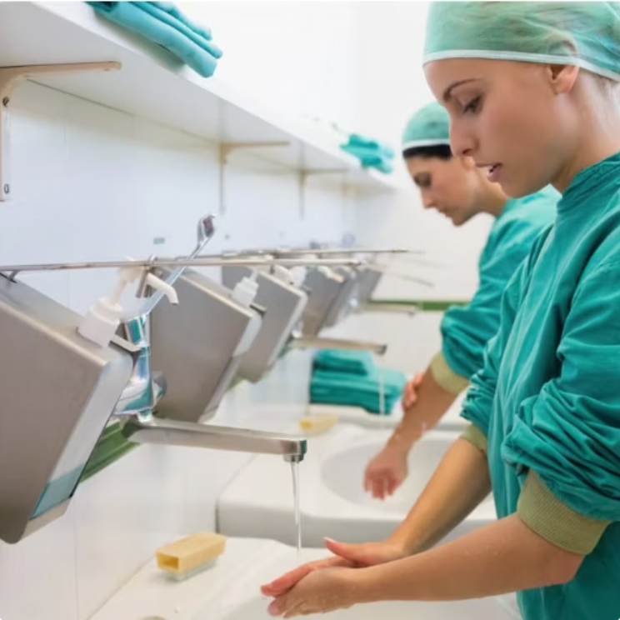
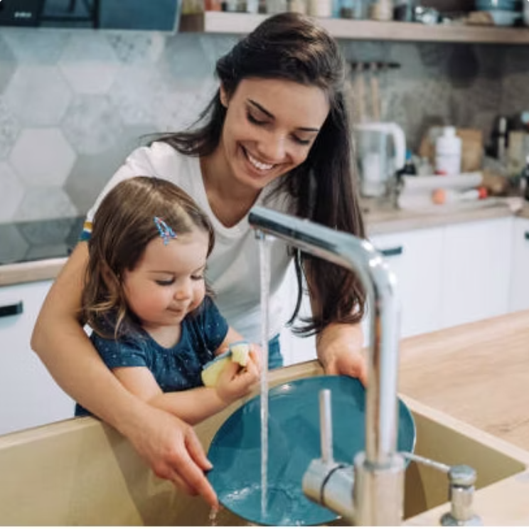
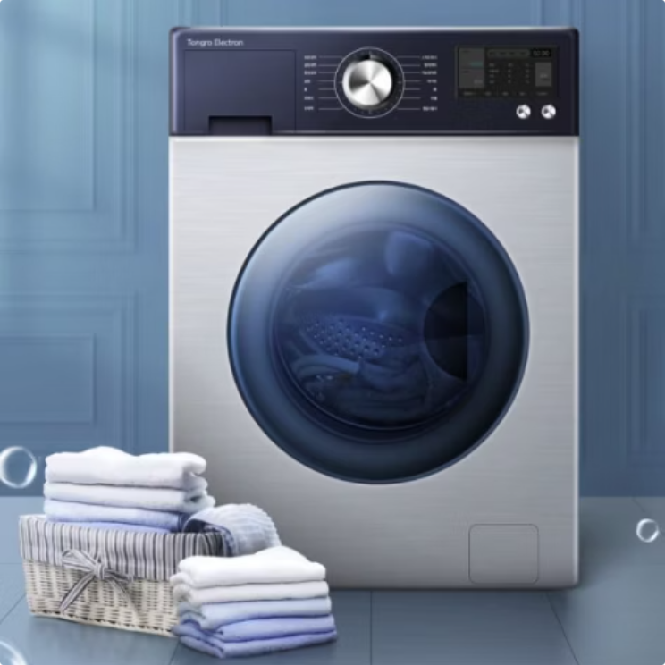

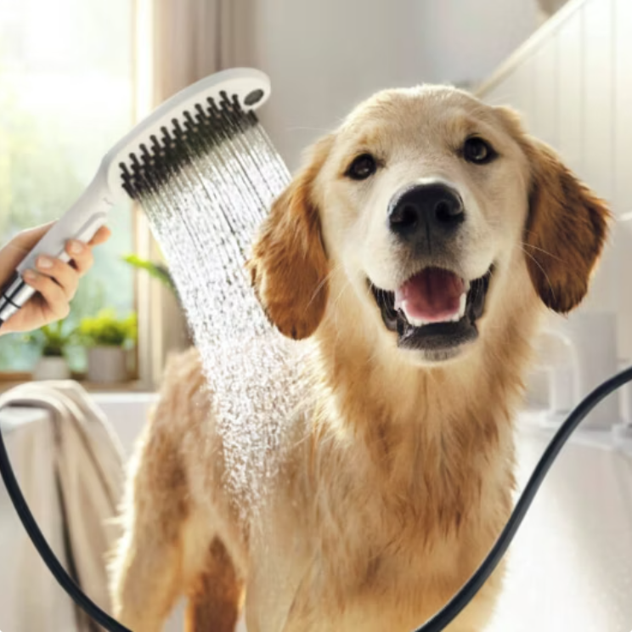
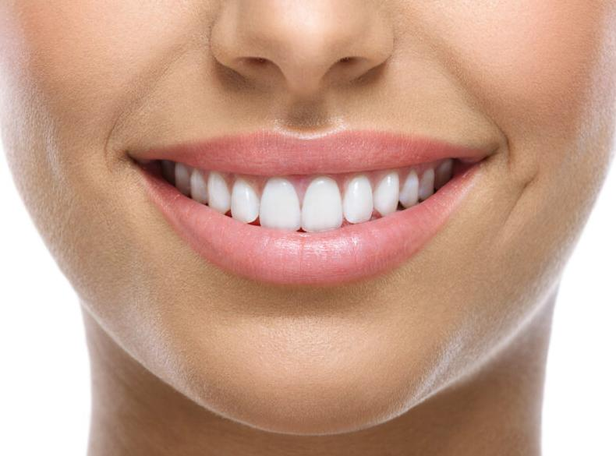
Applications
Hospital
Kitchen
Laundry
Sterilization for medical equipment and handwash
Sanitizing food, fruits, meat, plates,vegetable
Disinfecting for the clothes, get rid of laundry detergent
Restaurant
Dental care
Grooming
Sanitizing plates and dishes, food, fruits
Personal Oral Care
Sanitizing pet grooming

Slide 9









Germany Headquarter
Aquapur Europe GmbH
Hans-Thoma-Weg 3, DE 71032 Boeblingen, Germany
Contact: Kenneth George Smith
Email: kgs-aquapure@gmx.eu
Tel: 0049 7031 229688
Shenzhen Office
Aquapure Shenzhen Ozone Technology Co.,ltd
Room A4029, Nanfeng Building, Nanshan District, Shenzhen,China
Email: info@aquapureasia.com
Tel/WeChat: 00 86 18664924389

